Slide 1
Group 1
Open Source Work-Through
106-1 2018/1/4 Software Engineering Design
王瀚磊、王本奕、蔡佳昱、林凡煒、
張嘉豪、方珮雯、張育瑄

Slide 3
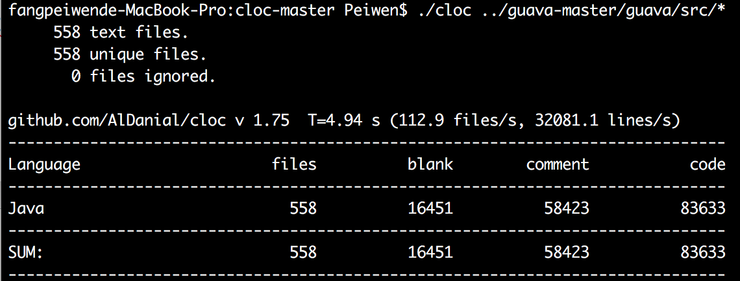
Line of codes

Slide 4
Packages

Slide 5
Graph & IO
Graph & IO
Concurrency & Hash
Reflection
EvenBus & Cache
ImmutableSet
Multiset & Multimap
BiMap &Table

Slide 6
Graph

Slide 7
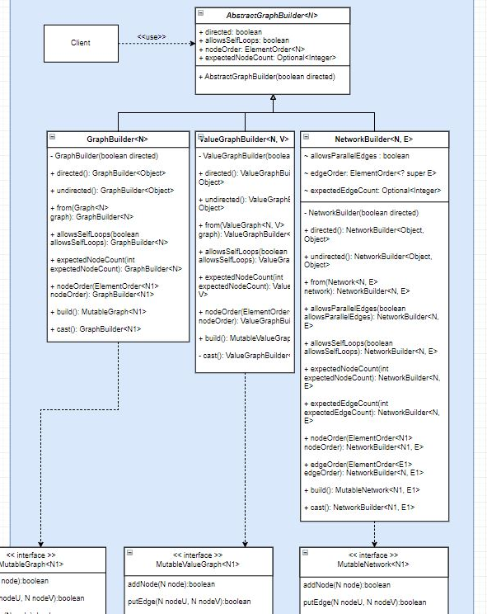
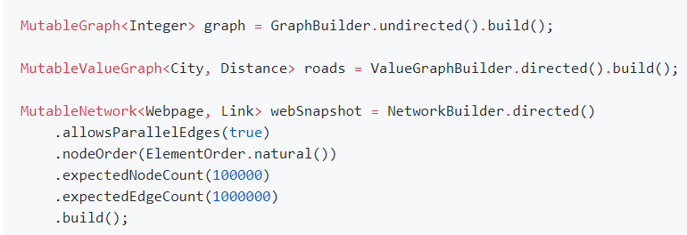
Graph
Builder
There are three types in com.google.common.graph:
Graph: Unique nodes and unique edges
eg. Graph<Airport>
ValueGraph: Unique nodes and unique valued edges
eg. Graph<Airport, Integer>
Network: Unique nodes and non-unique valued edges
eg. Graph<Airport, Flight>
Notes:
allowSelfLoop 預設false
Builder必須先定義有向或是無向才會返回instance，其中每個operator都是返回自己，因此可以用這種語法，最後在build的時候也就是在createinstance的時候再把自己丟給被Create的instance，他們會再去builder中取出需要的attribute
Trees/forest, k-partite 這類的結構無法explicit的支援，但仍能用現有結構創造

Slide 8
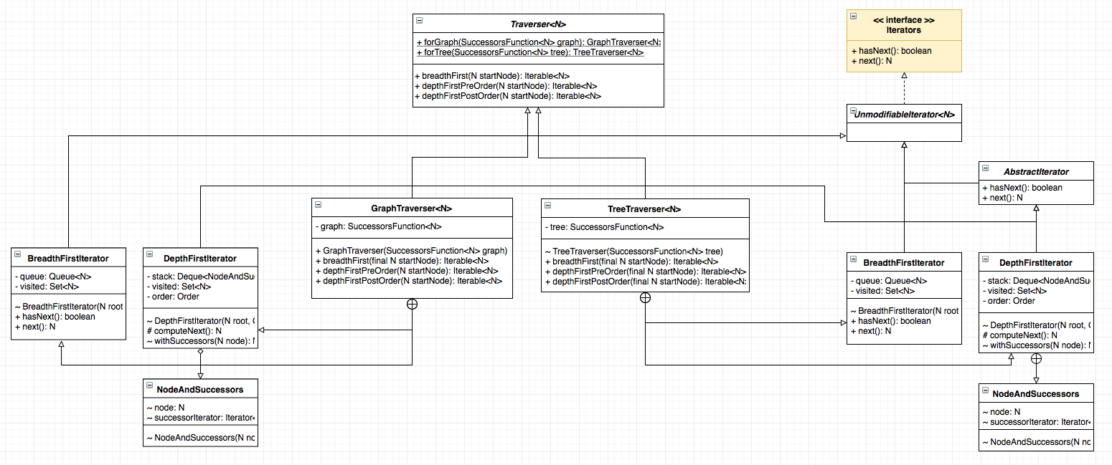
Graph
Iterator
Notes:
Iterable (getIterator): Traverser
Innerclass
Iterator(hasNext, next): iterator
為什麼要用innerClass? 我們在創建concreate class的時候考慮到要使用到別的class的attribute的時候時常需要思考該如何擁有這個reference，而這招可以避免
另外一個好處是可以做好封裝

Slide 9
IO

Slide 10
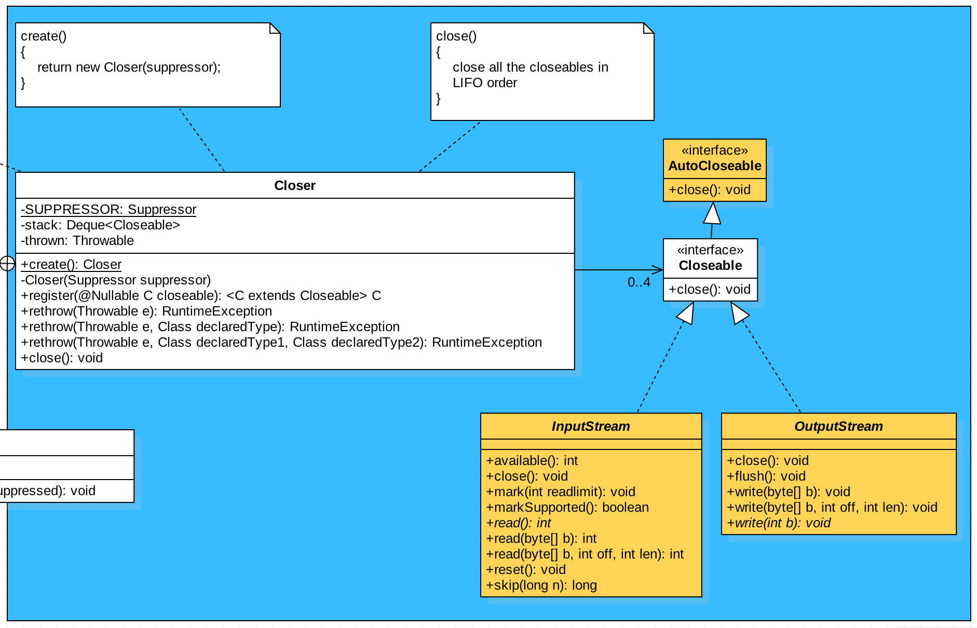
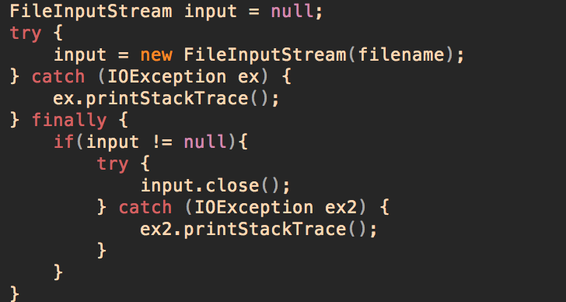
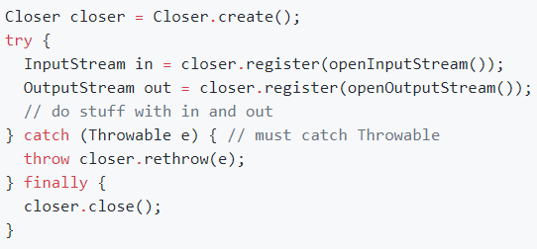
IO
Observer
When using file IO, we often considering about close file safely in the end with try-catch-finally or try-with-resources(JDK 7+).
Notes:
因為一個file通常我們只會開read/write stream，也就是同時就只有最多兩個stream需要做IO處理，因此作者在這邊只開少數幾個container來做管理
這邊所使用的是結構是stack，因此會利用LIFO的順序關閉stream
其實這邊還有一個很小的factory method(static): create
另外考慮上面這張圖的code，要是catch/finally都有exception，只會吐finally裡面的，這就叫做suppressed exception，為了處理這個狀況，guava的closer也有特別處理。

Slide 11
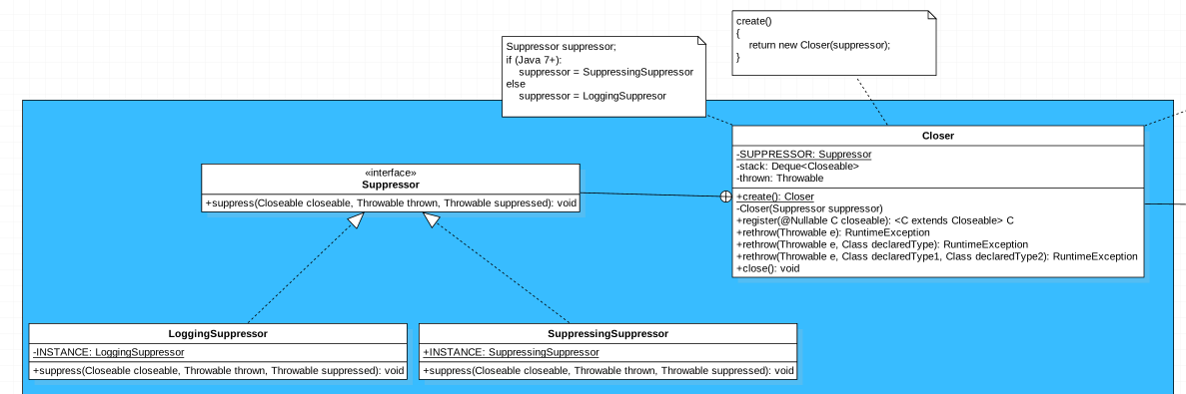
IO
Strategy
If an exception was thrown in the try block, any exceptions thrown when attempting to close a closeable will be suppressed. Otherwise, the first exception to be thrown from an attempt to close a closeable will be thrown and any additional exceptions that are thrown after that will be suppressed.
JDK 7+: Exceptions are suppressed by adding them to the exception that will be thrown using
Throwable.addSuppressed.
JDK 6: Exceptions are suppressed by logging them instead.

Slide 12
Concurrency & Hash
Graph & IO
Concurrency & Hash
Reflection
EvenBus & Cache
ImmutableSet
Multiset & Multimap
BiMap &Table

Slide 13
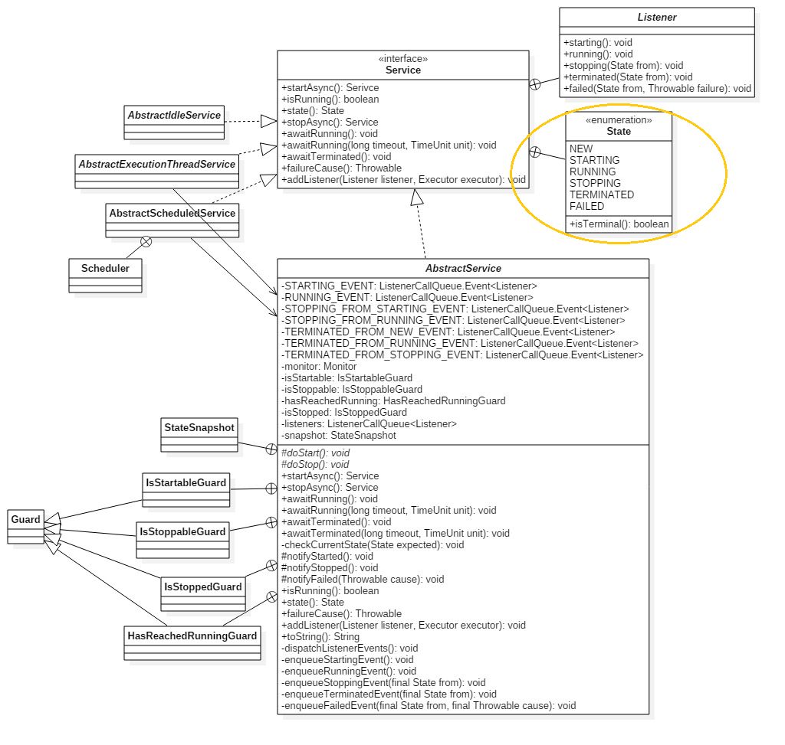
Service
State pattern

Slide 14
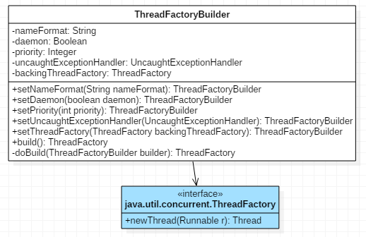
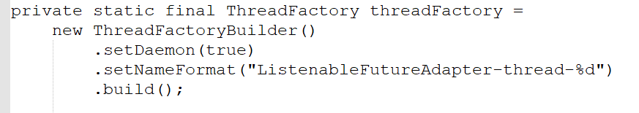
ThreadFactoryBuilder
Builder pattern

Slide 15
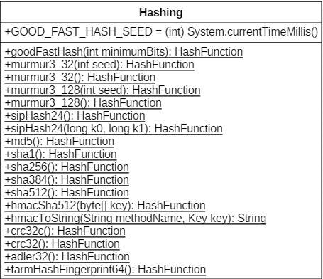
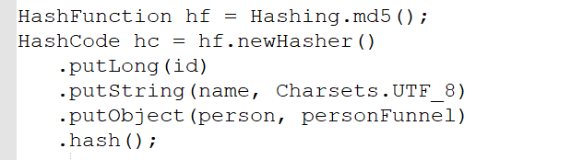
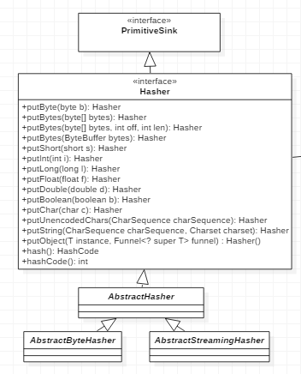
Hash
Example code
Hashing : Factory pattern
Hasher: Builder pattern

Slide 16
Reflection
Graph & IO
Concurrency & Hash
Reflection
EvenBus & Cache
ImmutableSet
Multiset & Multimap
BiMap & Table

Slide 17
purpose
Find relationships between generic type classes ex: List<Integer> ⬄ List<string>?
Universal query interface ex:
List<string> List<string>[]
List<? Extends A>…
resolve
TypeToken<>
Notes:
http://loveshisong.cn/%E7%BC%96%E7%A8%8B%E6%8A%80%E6%9C%AF/2016-02-16-Type%E8%AF%A6%E8%A7%A3.html
Type包含TypeVariable( 类型变量)、ParameterizedType(變數類型，就是泛型類)、
GenericArrayType( 数组类型:T[]、List<string>[]，由ParameterizedType或TypeVariable組成的array)、
WildcardType(通用泛型，? Extends int)、class()

Slide 18
http://loveshisong.cn/%E7%BC%96%E7%A8%8B%E6%8A%80%E6%9C%AF/2016-02-16-Type%E8%AF%A6%E8%A7%A3.html
Type包含TypeVariable( 類型變量，是泛型本身，如List<E>中的E)、
ParameterizedType(變數類型，就是泛型類:Map<String, String>)、
GenericArrayType( 數組類型:T[]、List<string>[]，由ParameterizedType或TypeVariable組成的array)、
WildcardType(通用泛型，? Extends int)、
class(原生類型)

Slide 19
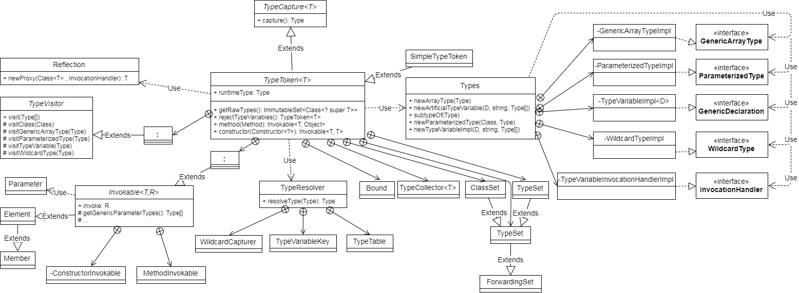
Class Diagram

Slide 20
Class Diagram
Main functions
Get type of classes
Invokable method
Notes:
Invoker: 實作get方法相關的變數如輸入、輸出…
Main func: 取型別、取父淚、取子類

Slide 21
Bridge Pattern

Slide 22
Bridge Pattern
getGenericComponentType(): Type

Slide 23
Class Diagram
Main functions
Get type of classes
Invokable method
Notes:
Invoker: 實作get方法相關的變數如輸入、輸出…

Slide 24
Visitor Pattern

Slide 25
EvenBus & Cache
Graph & IO
Concurrency & Hash
Reflection
EvenBus & Cache
ImmutableSet
Multiset & Multimap
BiMap & Table

Slide 26
Cache

Slide 27
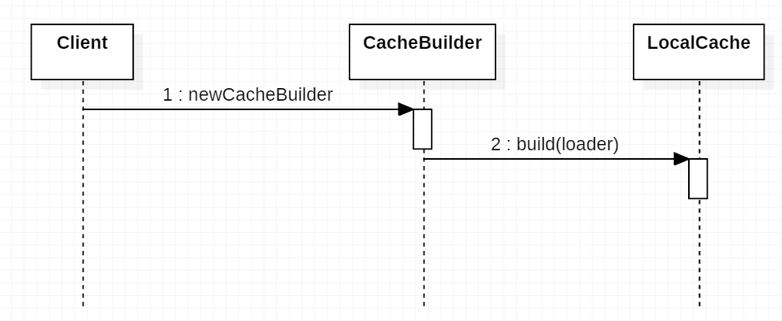
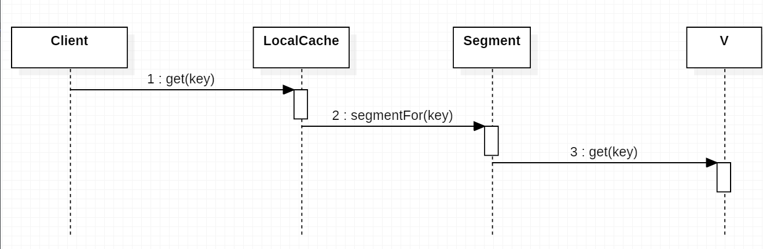
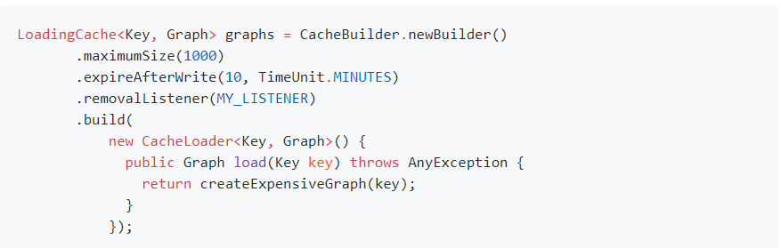
Cache
Building
Getting

Slide 28
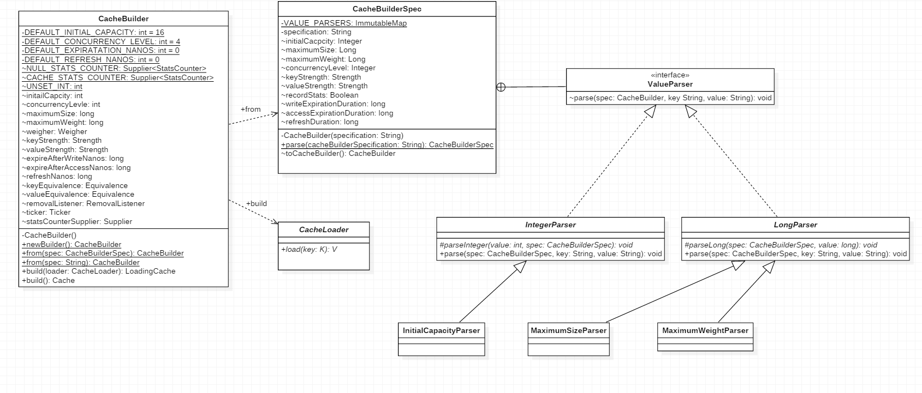
Builder Pattern

Slide 29
EventBus

Slide 30
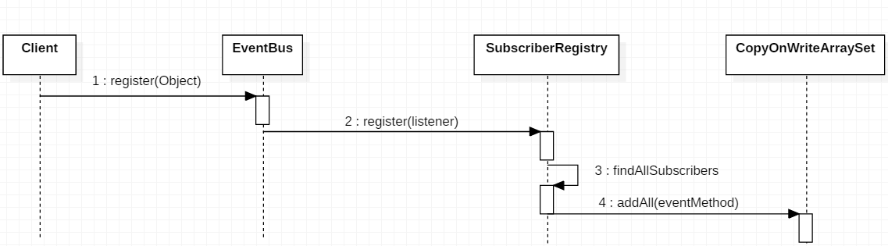
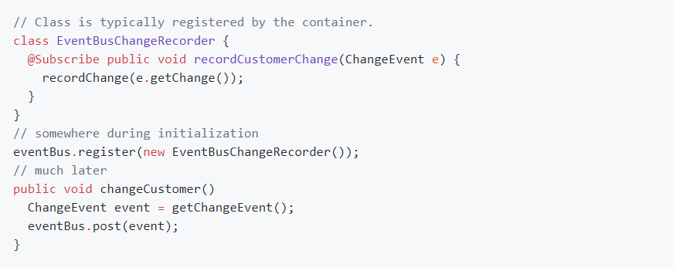
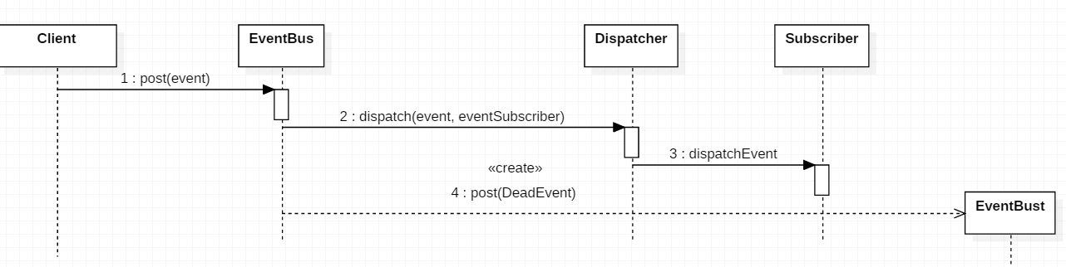
EventBus
Observer: Subscriber
Observable: Event

Slide 31
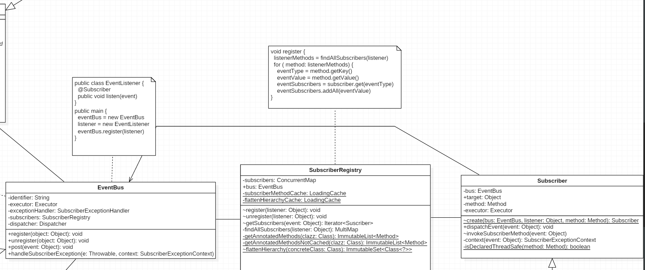
Observer Pattern

Slide 32
Immutable Set
Graph & IO
Concurrency & Hash
Reflection
EvenBus & Cache
ImmutableSet
Multiset & Multimap
BiMap & Table

Slide 33
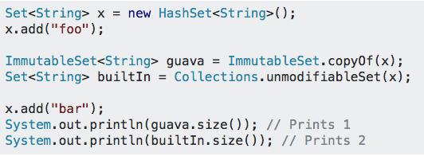
Immutable
Safe for use by untrusted libraries.
Thread-safe: can be used by many threads with no risk of race conditions.

Slide 34
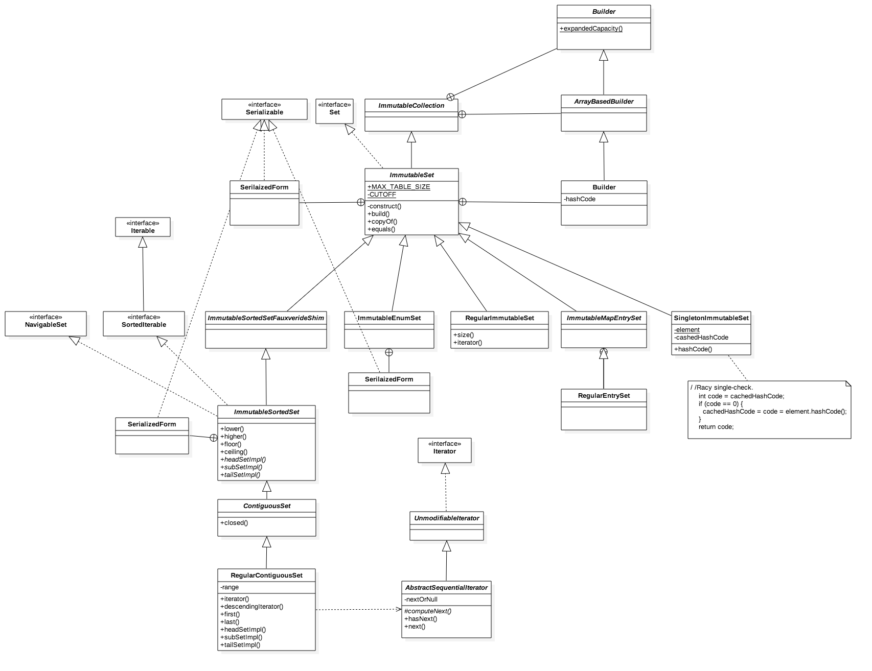
Notes:
NavigableSet: lower(), higher(), floor(), ceiling()

Slide 35
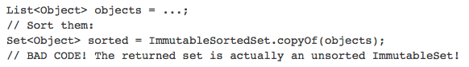
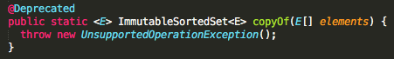
ImmutableSortedSetFauxverideShim
“Overrides” the ImmutableSet static methods
Lack ImmutableSortedSet equivalents with deprecated

Slide 36
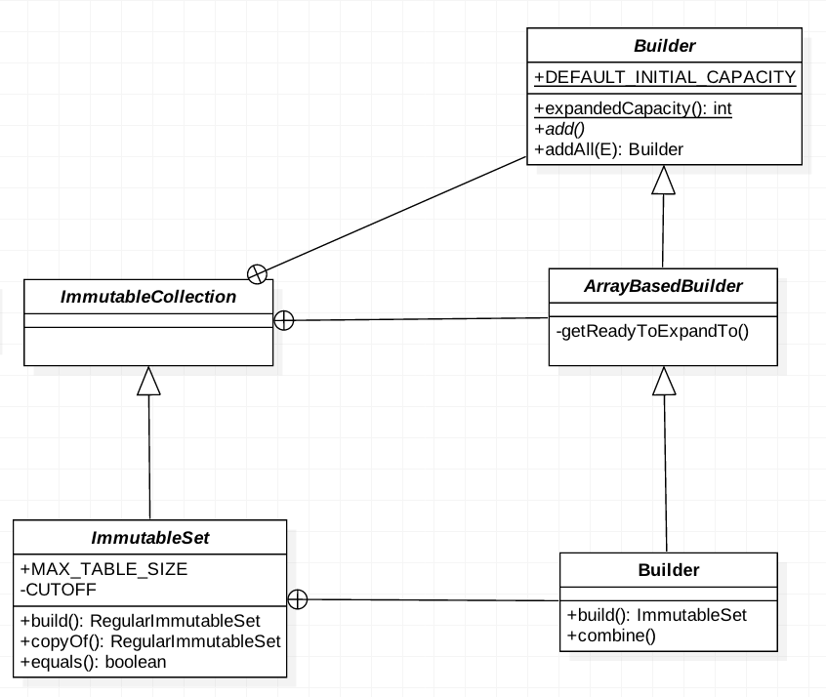
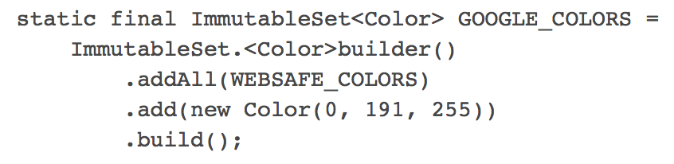
Builder
Notes:
Immutable Collection 的 Builder 定義好 Set 的大小，這個 Builder 裡面的 addAll 有呼叫 add ，但是 add 在這層尚未實作，
Builder 的 expandedCapacity 只是將改變後變數的大小回傳
在 Immutable Collection 的 ArrayBasedBuilder 繼承 Builder，在 Array based builder 裡面有一個 function 是 getReadyToExpandTo，
是用來增加 builder 的 capacity ，會用到 java.utl.Arrays 的 copyOf，在Array based builder 裡面實作 add 的功能，並且 override builder 的 addAll
在 Immutable Set 裡面的 Builder 繼承了 Immutable Collection 的 Array based builder ，這個 builder 裡面有一個 function combine ，可以將其它的 builder
與現在要 new 的 builder 結合，其實就是把一個 builder 的 contents 加進來。藉由 build function，builder 會新增一個 Regular Immutable Set 並且以 Immutable set
的型態回傳

Slide 37
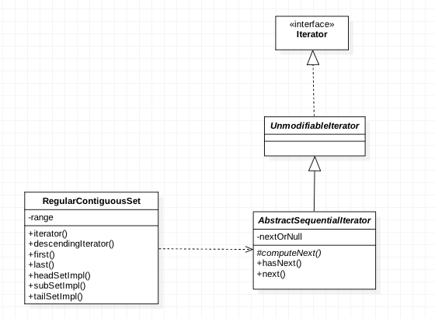
Iterator
Notes:
private T nextOrNull;
/** Creates a new iterator with the given first element, or, if firstOrNull is null, creates a new empty iterator.
protected AbstractSequentialIterator (@Nullable T firstOrNull)
{
this.nextOrNull = firstOrNull;
}

Slide 38
Multiset & Multimap
Graph & IO
Concurrency & Hash
Reflection
EvenBus & Cache
ImmutableSet
Multiset & Multimap
BiMap & Table

Slide 39
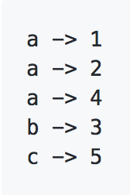
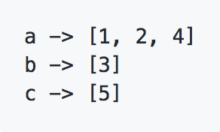
Multiset
Multimap
a
a
a
b
c
<a , 3>
<b , 1>
<c , 1>
Fig. 1
Fig. 2
Fig. 3
Fig. 4
views | structure | example
elementSet() | Set<E> | {a,b,c}
entrySet() | Set<Multiset.Entry<E>> | Fig.2
count(E) | int | count(1) = 3
size() | int | 5
views | structure | example
asMap | Map<K,V> | Fig. 3
entries | Collection <Map.Entry<K, V>> | rows in Fig. 1
keyset | Set<E> | {a,b,c}
keys | Multiset<E> | {a:1, b:1,c:1}
values | Collection<V> | {1,2,3,4,5}
Both Multiset & Multimap are not Maps!

Slide 40
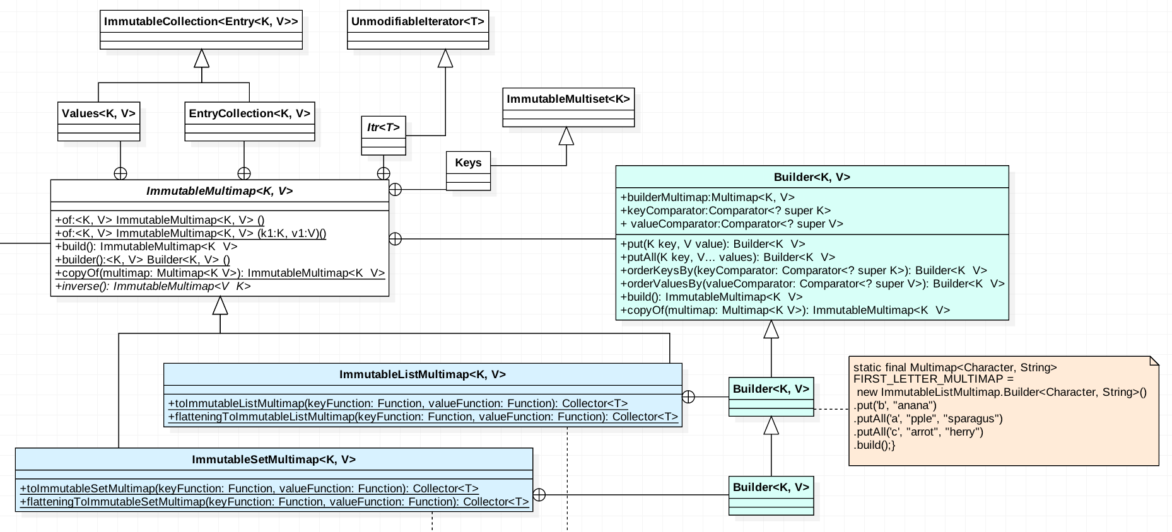
ImmutableMultimap--Builder

Slide 41
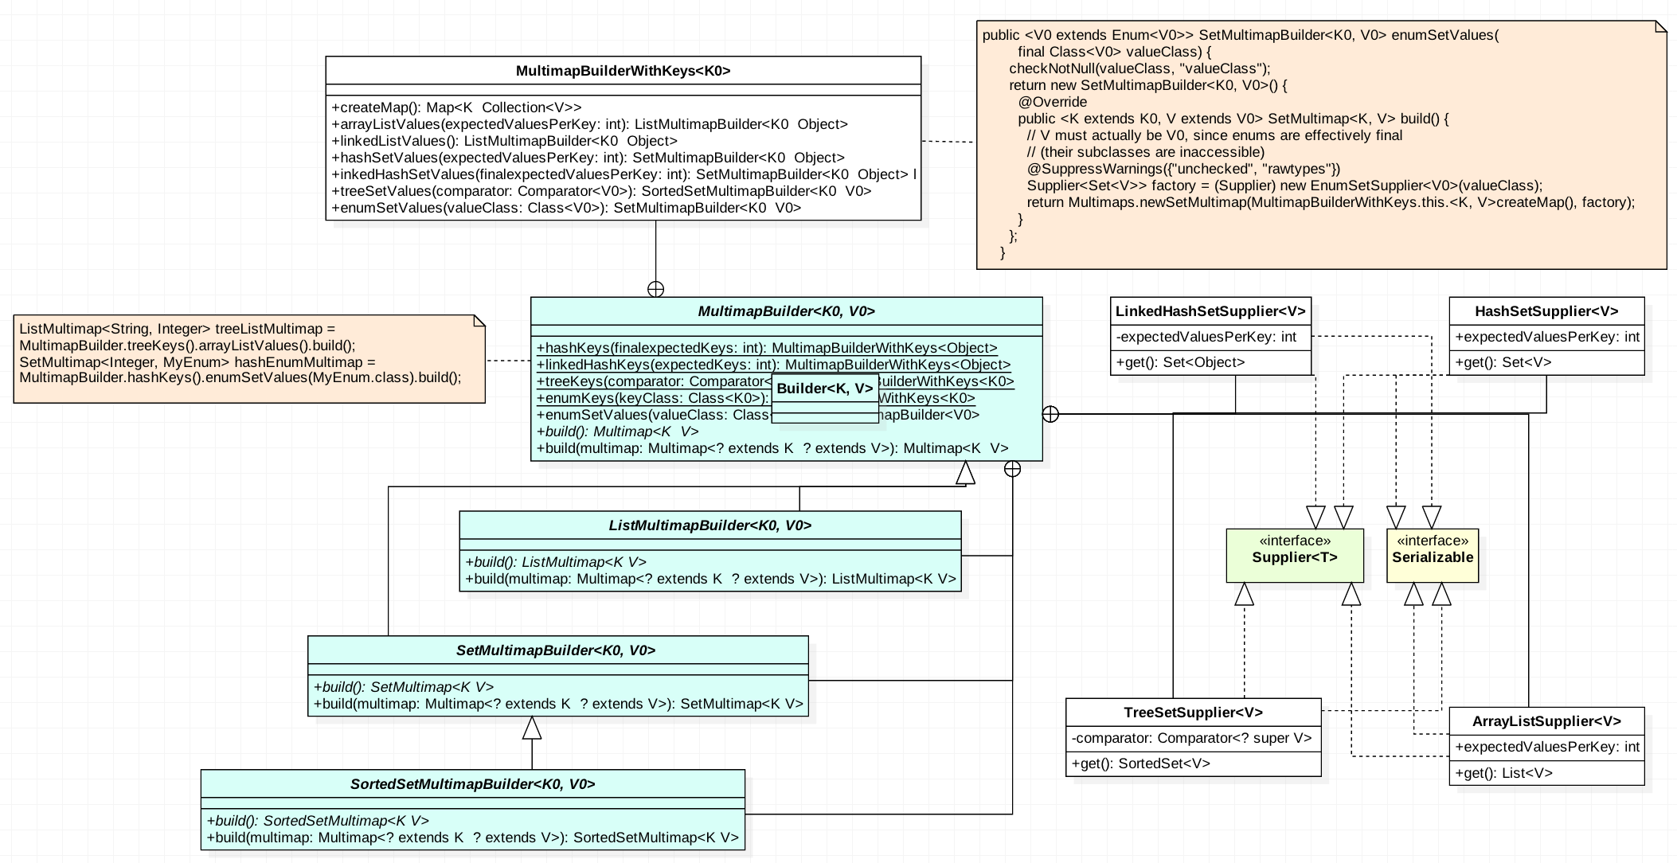
Multimap -Builder
Step 2
Step 1
Step 3

Slide 42
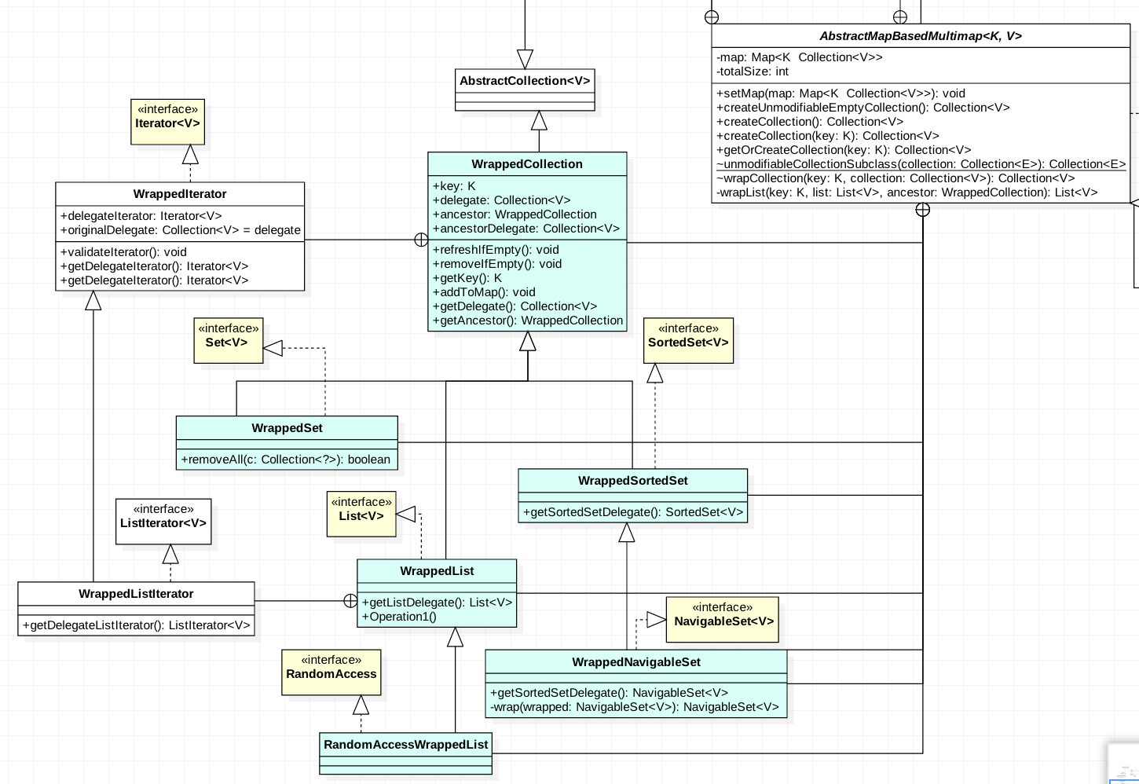
Wrapped Collection

Slide 43
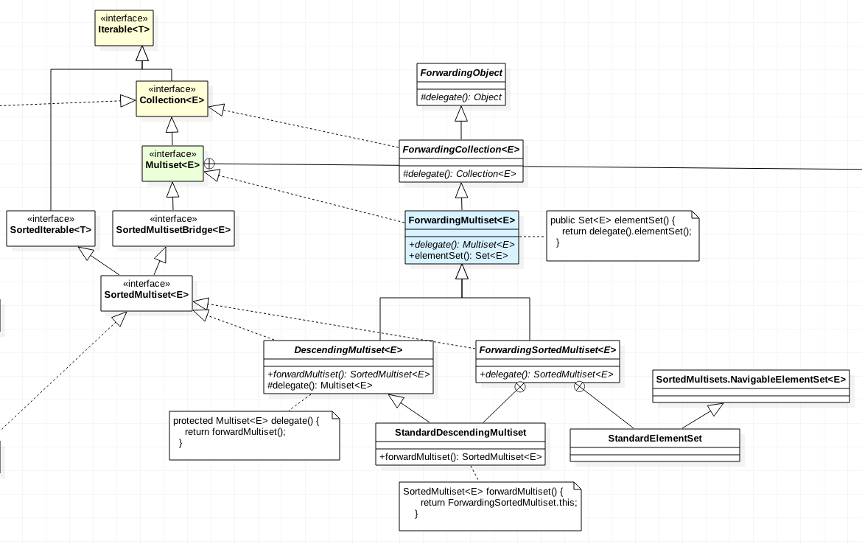
ForwardingMultiset

Slide 44
BiMap & Table
Graph & IO
Concurrency & Hash
Reflection
EvenBus & Cache
ImmutableSet
Multiset & Multimap
BiMap & Table

Slide 45
BiMap
A map in which the $\left(key, value\right)$ pairs form a one-to-one correspondence
Map<String, Integer> nameToId = Maps.newHashMap();
Map<Integer, String> idToName = Maps.newHashMap();
nameToId.put("Bob", 42);
idToName.put(42, "Bob");
idToName.get(42);
BiMap<String, Integer> nameToId = HashBiMap.create();
nameToId.put("Bob", 42);
BiMap<Integer, String> idToName = nameToId.inverse();
idToName.get(42);
Notes:
簡單來說就是 key 跟 value 都是 unique 的
所以可以用 key 查 value 也可以用 value 查 key

Slide 46
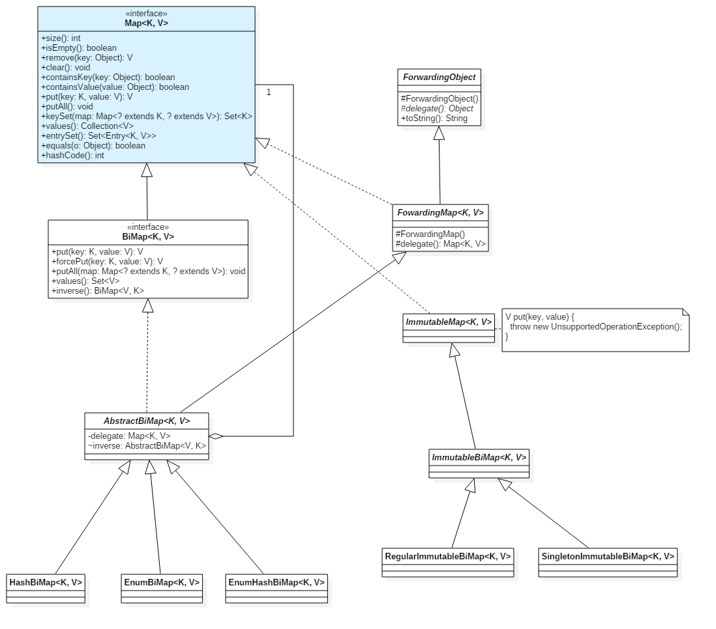
Notes:
主要分為 mutable 跟 immutable
Hash Enum EnumHash 底層用不同 map 實作
forwarding 後面會講
immutable map setter 都會丟 exception

Slide 47
Table
A map whose entries are $(rowKey, columnKey, value)$ tuples (i.e., a nested map)
Map<V, Map<V, Integer>> g = Maps.newHashMap();
…
if (!g.containsKey(v1)) {
g.put(v1, new Map<V, Integer>());
}
g.get(v1).put(v2, 4);
g.get(v1).put(v3, 20);
if (!g.containsKey(v2)) {
g.put(v2, new Map<V, Integer>());
}
g.get(v2).put(v3, 5);
g.get(v1).get(v3);
Table<V, V, Integer> g = HashBasedTable.create();
…
g.put(v1, v2, 4);
g.put(v1, v3, 20);
g.put(v2, v3, 5);
g.get(v1, v3);
Notes:
簡單來說就是兩個 key 查一個 value 的 map

Slide 48
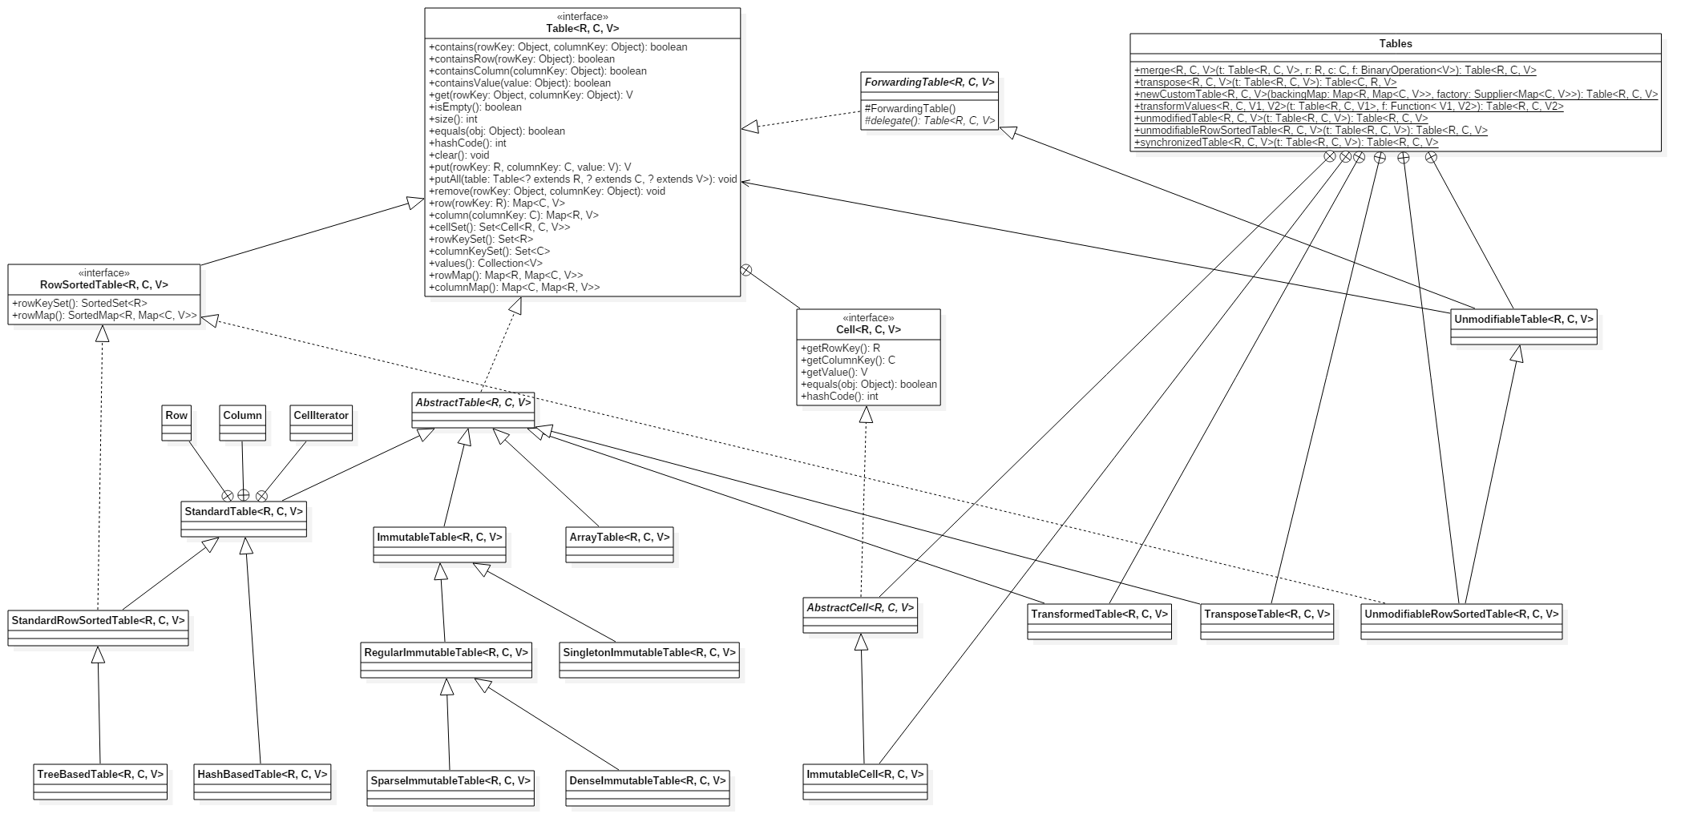

Slide 49
Functionality Extension
Suppose we want to keep count of the number of attempted element insertions of a Set
Set<E> set = new MySet<E>();
set.add(e1);
set.add(e2);
set.remove(e1);
set.addAll(e3, e4, e5);
set.remove(e2);
set.getAddCount(); // 5
public class OldSet<E> implements Set<E> {
public boolean add(E e) {
...
}
public boolean addAll(Collection<? extends E> c) {
for (E e : c) {
add(e);
}
}
}

Slide 50
Naïve Approach: Inheritance
What’s wrong with the following code?
public class GarbageSet<E> extends OldSet<E> {
private int addCount = 0;
@Override
public boolean add(E e) {
addCount += 1;
return super.add(e);
}
@Override
public boolean addAll(Collection<? extends E> c) {
addCount += c.size();
return super.addAll(c);
}
public int getAddCount() {
return addCount;
}
}
Set<E> set = new GarbageSet<E>();
set.add(e1);
set.add(e2);
set.remove(e1);
set.addAll(e3, e4, e5);
set.remove(e2);
set.getAddCount(); // ?
Notes:
? = 8

Slide 51
Forwarding: Composition
public abstract class ForwardingSet<E> implements Set<E> {
protected abstract Set<E> delegate();
public boolean add(E e) {
delegate().add(e);
}
public boolean addAll(Collection<? extends E> c) {
delegate().addAll(c);
}
}
public class MySet<E> extends ForwardingSet<E> {
private Set<E> delegate;
private int addCount = 0;
public MySet(Set<E> delegate) {
this.delegate = delegate;
}
@Override
public Set<E> delegate() {
return delegate;
}
@Override
public boolean add(E e) {
addCount += 1;
return super.add(e);
}
@Override
public boolean addAll(Collection<? extends E> c) {
addCount += c.size();
return super.addAll(c);
}
public int getAddCount() {
return addCount;
}
}

Slide 52
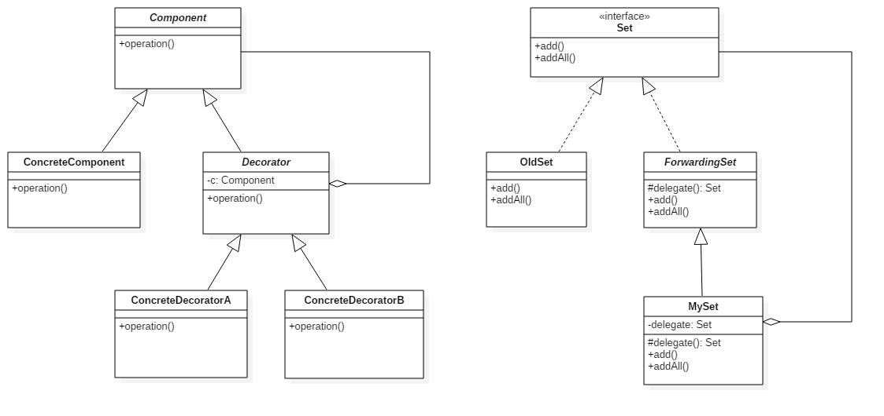
Decorator Pattern

Slide 53
Summary: Design Patterns in Guava
Builder
EventBus
Collect
Iterator
EventBus
Collect
Singleton
Decorator
Observer
EventBus
EventBus
Cache
Cache
Collect
Base
Primitive
IO
Graph
Graph
Graph
Cache
Escape
Cache
IO
Primitive
Base
Collect
Cache
EventBus
Factory
Strategy
EventBus
Cache
Bridge
Reflection
Visitor
Reflection
Adapter
Null
State
Base
Base
IO
Primitive

Slide 54
Appendix: Meeting minutes
Date | 9/25 | 10/2 | 10/10 | 10/16 | 10/23 | 11/1 | 11/5 | 11/6 | 11/22 | 11/28 | 12/4 | 12/11 | 12/26 | 1/2 | 1/3
Time | 2 hr | 2 hr | 2.5 hr | 2.5 hr | 2 hr | 1.5 hr | 1.5 hr | 2 hr | 1 hr | 2 hr | 2 hr | 3.5 hr | 3.5 hr | 2 hr | 1.5 hr
ppl. | 7 | 7 | 7 | 7 | 6 | 4 | 6 | 7 | 6 | 7 | 6 | 7 | 7 | 7 | 7
Name | 張育瑄 | 林凡煒 | 王本奕 | 王瀚磊 | 張嘉豪 | 蔡佳昱 | 方珮雯
# of attendance | 15 | 15 | 14 | 14 | 14 | 12 | 14
Notes:
https://docs.google.com/spreadsheets/d/1UBu9hQM2tDP5awsydyXffwZSZ4XvwuKVxFLLurpiKBE/edit#gid=299445815

Slide 55
Appendix: WBS
Task | Best Case | Most Likely | Worst Case | Expected Case | Standard Deviation | Variance | Effort Estimation | Task Owner | Start Date | Finish Date | Actual Effort | Predictable
Sets | 5 | 12 | 16 | 11.50 | 6.54 | 42.71 | 13.16 | 張嘉豪 | 2017/12/18 | 2017/12/31 | 50 | V
Multisets | 20 | 24 | 27 | 23.83 | 4.16 | 17.29 | 24.89 | 方珮雯 | 2017/10/12 | 2017/11/30 | 50 | X
Maps | 30 | 34 | 37 | 33.83 | 4.16 | 17.29 | 34.89 | 張育瑄 | 2017/10/12 | 2017/11/24 | 43 | X
Multimaps | 20 | 24 | 27 | 23.83 | 4.16 | 17.29 | 24.89 | 方珮雯 | 2017/12/29 | 2018/01/03 | 20 | V
Bitmap | 7 | 9 | 12 | 9.17 | 2.97 | 8.82 | 9.92 | 張育瑄 | 2017/11/25 | 2017/12/8 | 15 | X
Table | 8 | 14 | 18 | 13.67 | 5.94 | 35.29 | 15.17 | 張育瑄 | 2017/12/9 | 2017/12/31 | 23 | X
Range Set | 6 | 9 | 10 | 8.67 | 2.38 | 5.65 | 9.27 | 張嘉豪 | 2017/10/12 | 2017/10/25 | 23 | V
Rrange Map | 6 | 11 | 14 | 10.67 | 4.75 | 22.59 | 11.87 | 張嘉豪 | 2017/10/12 | 2017/10/25 | 23 | V
List | 2 | 3 | 4 | 3.00 | 1.19 | 1.41 | 3.30 | 張嘉豪 | 2017/10/28 | 2017/11/12 | 27 | X
Iterator | 4 | 5 | 6 | 5.00 | 1.19 | 1.41 | 5.30 | 張嘉豪 | 2017/10/28 | 2017/11/12 | 27 | X
Ordering | 4 | 5 | 6 | 5.00 | 1.19 | 1.41 | 5.30 | 張嘉豪 | 2017/11/16 | 2017/12/3 | 30 | V
Queue | 6 | 8 | 9 | 7.83 | 1.78 | 3.18 | 8.28 | 張嘉豪 | 2017/12/8 | 2017/12/17 | 26 | X
Notes:
https://docs.google.com/spreadsheets/d/1UBu9hQM2tDP5awsydyXffwZSZ4XvwuKVxFLLurpiKBE/edit#gid=299445815

Slide 56
Task | Best Case | Most Likely | Worst Case | Expected Case | Standard Deviation | Variance | Effort Estimation | Task Owner | Start Date | Finish Date | Actual Effort | Predictable
Graphs | 3 | 7 | 8 | 6.50 | 2.97 | 8.82 | 7.25 | 王瀚磊 王本奕 | 2017/10/28 | 2017/11/20 | 23 | X
Concurrency | 7 | 14 | 19 | 13.67 | 7.13 | 50.82 | 15.47 | 王瀚磊 王本奕 | 2017/10/28 | 2017/11/27 | 30 | X
Networking | 7 | 14 | 19 | 13.67 | 7.13 | 50.82 | 15.47 | 王瀚磊 王本奕 | 2017/11/27 | 2017/12/15 | 21 | V
I/O | 7 | 14 | 19 | 13.67 | 7.13 | 50.82 | 15.47 | 王瀚磊 王本奕 | 2017/12/15 | 2018/01/02 | 17 | V
Hashing | 3 | 7 | 8 | 6.50 | 2.97 | 8.82 | 7.25 | 王瀚磊 王本奕 | 2017/12/15 | 2017/12/29 | 14 | X
Caches | 7 | 10 | 14 | 10.17 | 4.16 | 17.29 | 11.22 | 林凡煒 蔡佳昱 | 2017/10/4 | 2017/10/31 | 27 | X
Base | 8 | 15 | 18 | 14.33 | 5.94 | 35.29 | 15.84 | 林凡煒 蔡佳昱 | 2017/11/1 | 2017/11/14 | 13 | V
Primitives | 7 | 10 | 14 | 10.17 | 4.16 | 17.29 | 11.22 | 林凡煒 蔡佳昱 | 2017/11/14 | 2017/11/28 | 14 | V
Escape | 2 | 3 | 5 | 3.17 | 1.78 | 3.18 | 3.62 | 林凡煒 蔡佳昱 | 2017/10/22 | 2017/11/16 | 26 | X
EventBus | 2 | 3 | 5 | 3.17 | 1.78 | 3.18 | 3.62 | 林凡煒 蔡佳昱 | 2017/12/4 | 2017/12/14 | 10 | V
Math | 5 | 7 | 10 | 7.17 | 2.97 | 8.82 | 7.92 | 林凡煒 蔡佳昱 | 2017/10/8 | 2017/10/22 | 14 | X
Reflection | 5 | 7 | 10 | 7.17 | 2.97 | 8.82 | 7.92 | 林凡煒 蔡佳昱 | 2017/11/16 | 2018/1/2 | 47 | X
Annotation | 1 | 1 | 1 | 1.00 | 0.00 | 0.00 | 1.00 | 林凡煒 蔡佳昱 | 2017/10/14 | 2017/10/14 | 1 | V

Slide 57
Thanks!
Any questions?

